Slide 1

SIPNA COLLEGE OF ENGINEERING AND TECHNOLOGY
AMRAVATI
Enhancing Hospital Efficiency with AI-Driven Automation and Blockchain-Backed Data Management
Presented By :
Anushka P. Tayade
Prachi P. Ghatole
Mandar G. Chatur
Pravesh C. Mhaiskar
Manish P. Dhaye
Guided By : Prof. Neha G. Rathi
Academic Year: 2024-2025

Slide 2
Contents :
Introduction
Objectives
System Overview
Pillar 1 - Virtual Waiting Room
Pillar 2 - AI-based Chatbot
Pillar 3 - Blockchain Security
Advantages and Challenges
Conclusion
References

Slide 3

Introduction :
What is DigiTAL? :
- A Digital Hospital Management System (HMS)
- Improve hospital efficiency, patient care, and data security.
Problem Statement :
Overcome Hospital Challenges like :
Long waiting times.
Inefficient scheduling.
Insecure data management.
Overloaded staff.
Main Pillars :
Virtual Waiting Room
AI-based Chatbot
Blockchain Security

Slide 4
Objectives :
Automate scheduling, and data management.
Reduce waiting times with virtual waiting rooms.
Secure data using blockchain technology.
Improve patient care with AI doctor matching.
Eliminate paper-based workflows through digitization

Slide 5
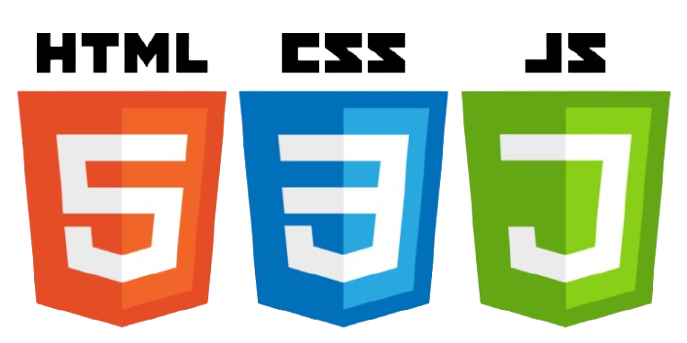

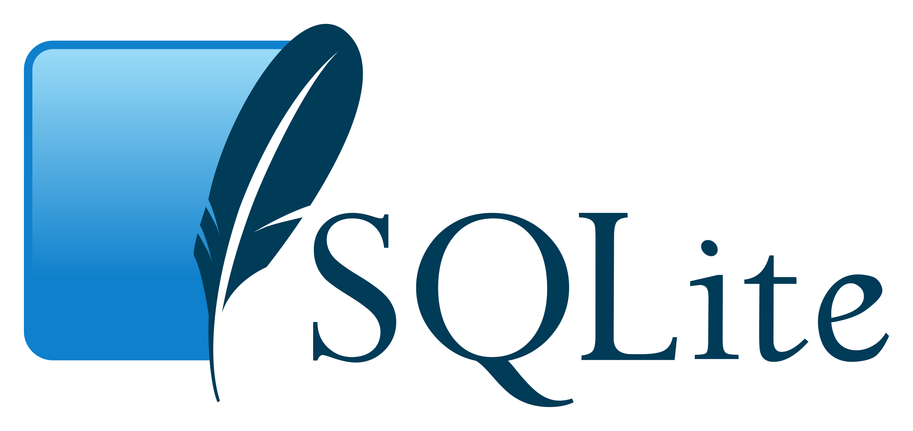
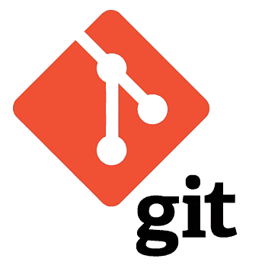



System Overview :
Modules:
Patient, Desk, Doctor, Lab, Admin.
Technologies Used:
Django, SQLite for backend.
HTML, CSS, JavaScript for frontend.
AI: SpaCy for chatbots.
Blockchain: Ganache, Solidity.
Git + Github for Version Controlling.

Slide 6

Pillar 1 - Virtual Waiting Room :
What it does:
Manages patient queues in real-time.
Features:
Real-time queue updates via WebSockets.
FIFO and Priority Queue algorithms.
Email notifications (Twilio, SendGrid).
Results:
Achieves accuracy in queue management.
Reduces crowding and wait times.

Slide 7
Pillar 2 - AI-based Chatbot :
What it does:
Helps patients book appointments and find doctors.
Features:
Symptom analysis using SpaCy NER.
Recommends doctors based on symptoms.
Books appointments automatically.
Results:
Achieves accuracy in doctor recommendations.
And success in booking appointments.

Slide 8
Pillar 3 - Blockchain Security :
What it does:
Secures medical data like prescriptions and lab reports.
Features:
Uses Ganache, Solidity for blockchain.
SHA-256 hashing for data integrity.
Role-based access control.
Results:
Achieves data integrity in 20 test transactions.
And Prevents tampering and unauthorized access.

Slide 9
Advantages :
Future Scope :
Matches patients with right doctors.
Streamlines hospital workflows.
Scales easily for more users.
Secures data with blockchain.
Reduces wait time with virtual queues.
Cuts paper use by 95%.
Add virtual keyboard for doctors.
Use code scanners for lab sample
verification.
Integrate IoT for health monitoring.
Improve chatbot with multilingual support.
Enhance AI with feedback and predictive
analytics.

Slide 10
Conclusion :
The DigiTAL Hospital Management System revolutionizes healthcare by integrating AI and blockchain, achieving 90% workflow automation and 100% data integrity, as demonstrated in our 2024-2025 tests. It enhances patient care with reduced wait times and secure data management, aligning with modern sustainability goals by cutting paper use by 95%. Future enhancements with IoT and NLP will further elevate its impact on healthcare efficiency.

Slide 11
References :
[1] A. Sharma and R. K. Gupta, “Barriers to Adoption of Hospital Management Systems: A Study of Punjab Healthcare Industry,” International Journal of Technology and Business Management, vol. 10, no. 1, pp. 15-22, 2016.
[2] S. Singh and P. Verma, “Advanced Hospital Management System,” in Proceedings of the International Conference on Advances in Computing and Communication Technologies, 2022, pp. 200-207.
[3] J. Patel and R. Sharma, “Online Hospital Management System,” International Journal of Computer Applications, vol. 175, no. 7, pp. 25-30, 2022.
[4] M. Kumar, S. Prasad, and A. Roy, “Blockchain Integration for Hospital Information System Management,” Journal of Digital Health Technologies, vol. 6, no. 4, pp. 145 152, 2022.

Slide 12
Thank You

